Slide 1
Be kind
… in code reviews

Slide 2
Dates and times: Hard, but not impossible
BY JON SKEET

Slide 3
Take-away: next time you work with date/time, take a few hours to grok it.
Everything else is filler.

Slide 4
Background
Notes:
Most of us have code that uses dates and times
A large proportion of it is wrong, I suspect – but maybe only a couple of times a year
There’s a lot of fear about the topic
Main message: it’s manageable, if you put some time in
Sub-message: use the right tools. For .NET, that’s Noda Time ☺

Slide 5
Key concepts

Slide 6
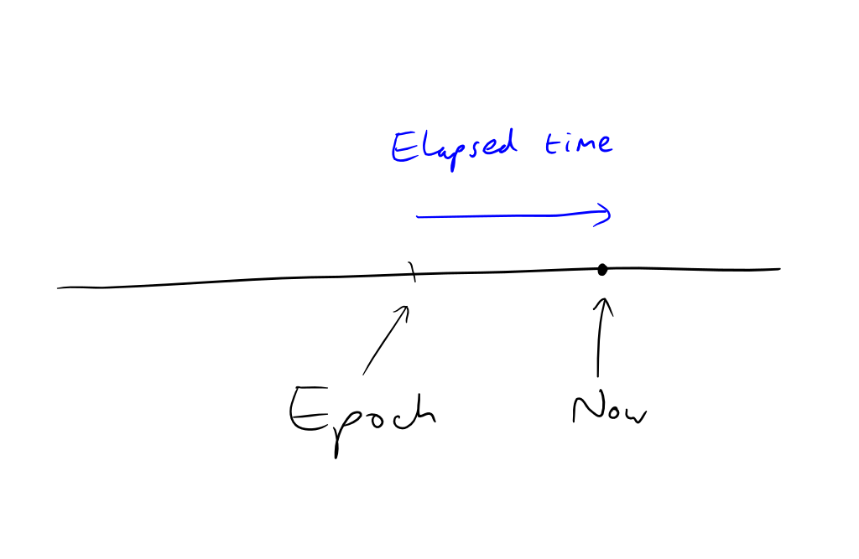
Instant
Notes:
Picture: timeline

Slide 7
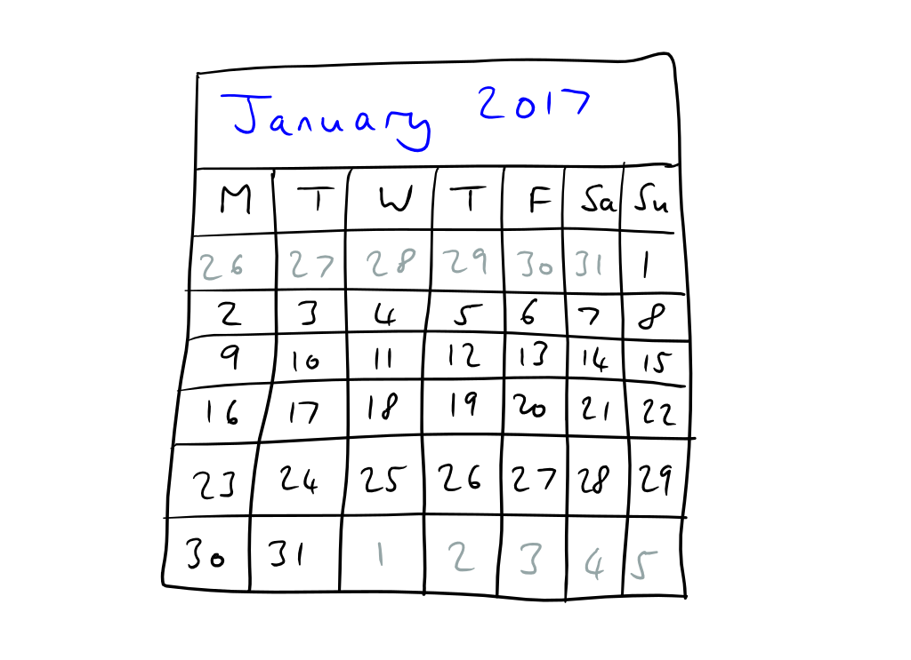
Calendar system (CalendarSystem)
Notes:
Picture: calendar
Artificial
Other calendar systems exist – be aware

Slide 8
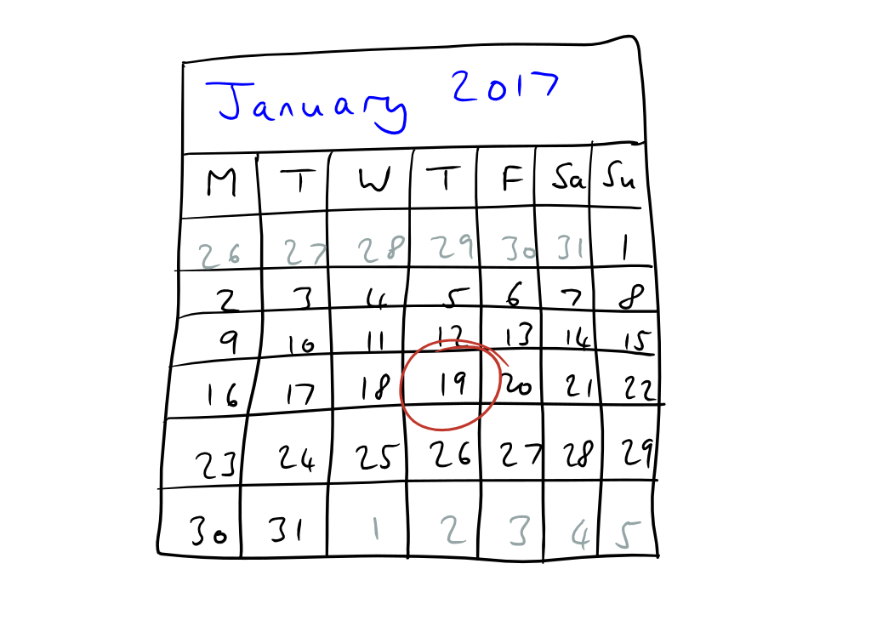
Date (LocalDate)
Notes:
Calendar with circled date (Jan 19th)

Slide 9
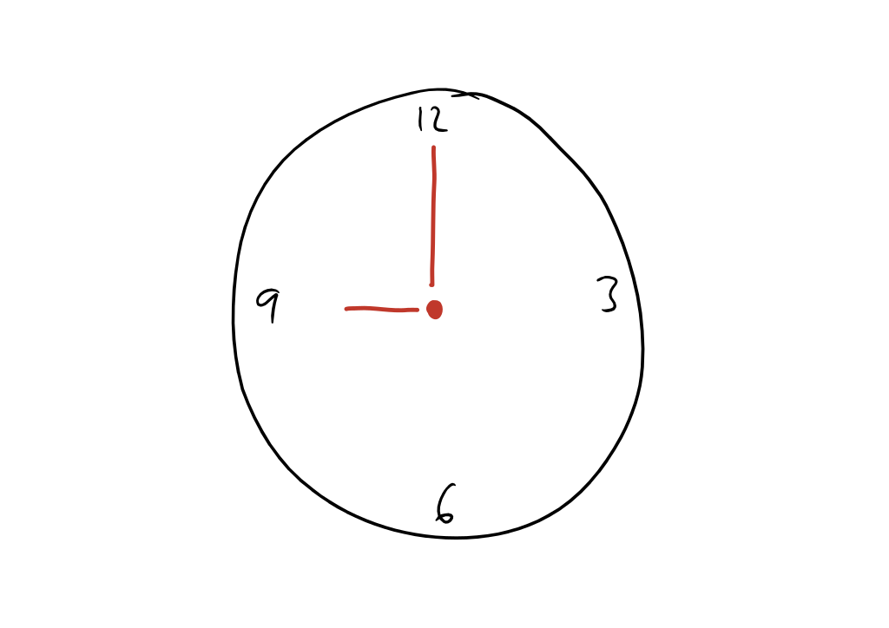
Time of day (LocalTime)
Notes:
Clock – note, no date

Slide 10
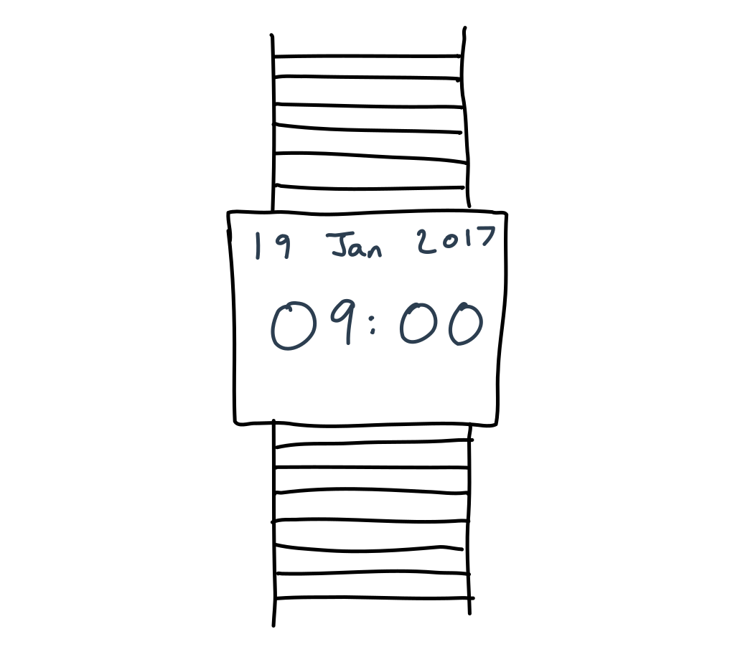
Date and time (LocalDateTime)

Slide 11
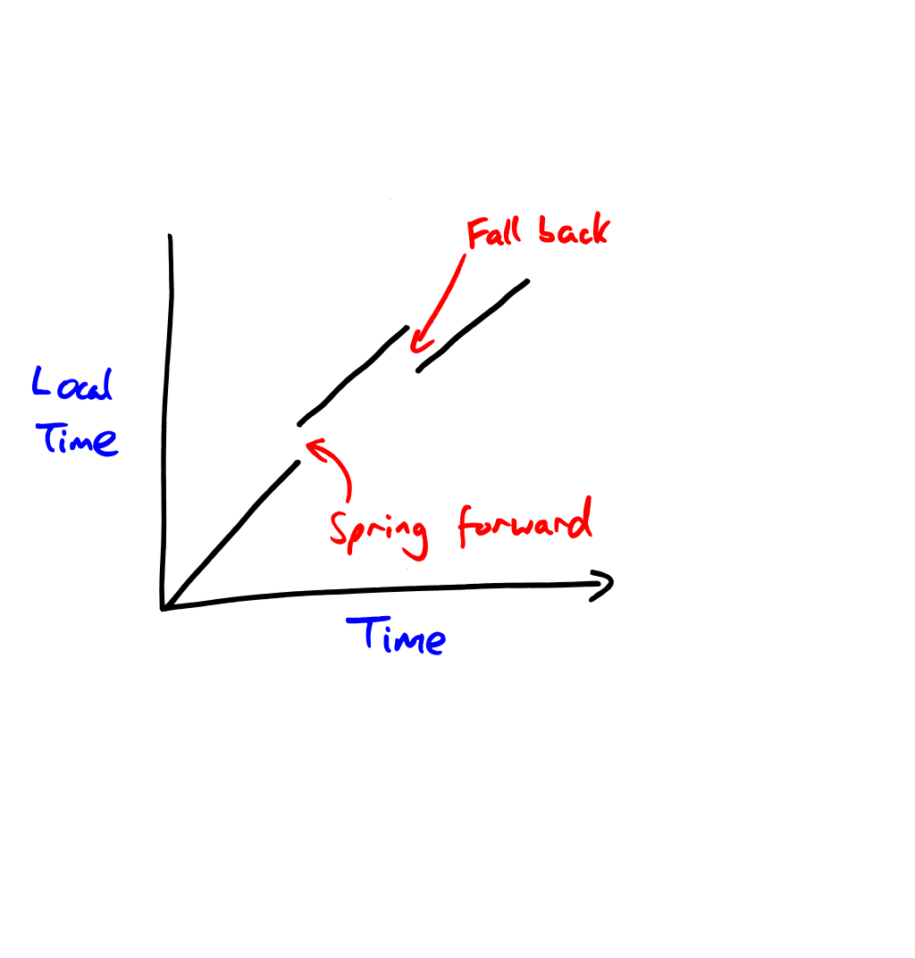
Time zones (DateTimeZone)
Notes:
Definition of a time zone
Ambiguous and skipped times

Slide 12
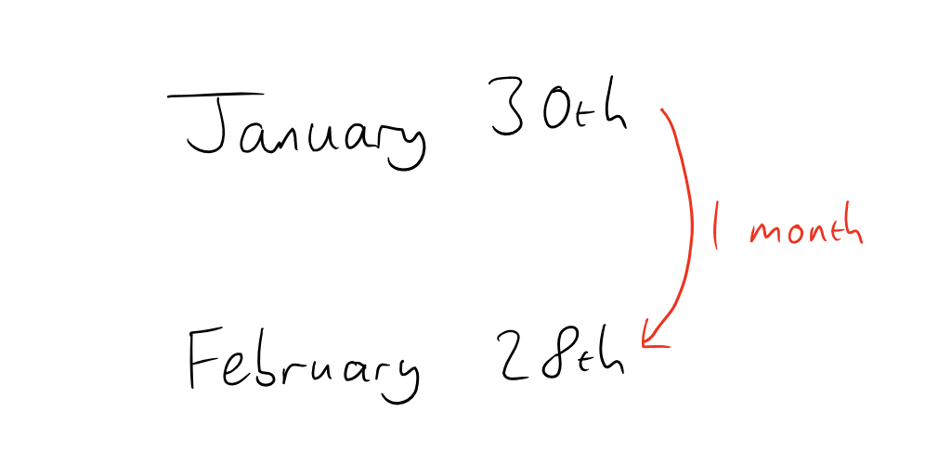
Period
Spot the illustration that wasn’t drawn in 2020!
In 2020, this period is 29 days.
Just one example of how calendar arithmetic is non-obvious

Slide 13
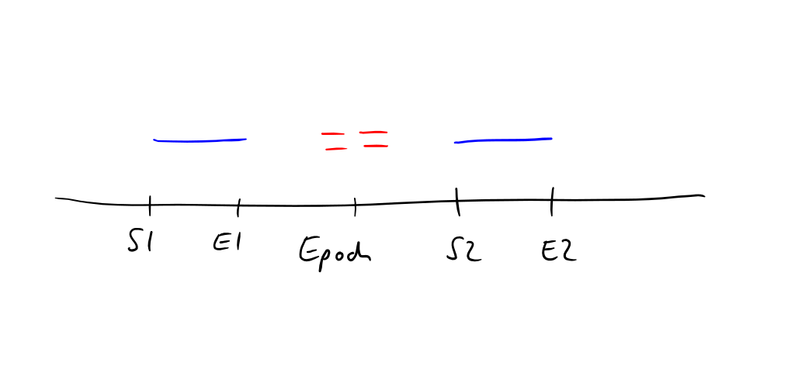
Duration

Slide 14
Problems and myths

Slide 15
DateTime.Now should not exist

Slide 16
Think!

Slide 17
Inject a clock

Slide 18
Avoid ambiguity
Notes:
DateTime is a pain for this. You can’t lean on the type system

Slide 19
Limit scope
Notes:
You probably don’t need to support leap seconds
You probably don’t need to support non-Gregorian calendars
Even in Sweden, you probably don’t need to support February 30th (1712 only)

Slide 20
Avoid time zone abbreviations
Notes:
“CST” can mean a lot of different things
Different places observing the same abbreviation at the moment may change at different times (or not at all)

Slide 21
Myth: just store UTC, and all will be well
Notes:
Okay for some things. You need to think about this.

Slide 22
UTC information loss
User in 2020: “Book a meeting for 9am on December 1st 2022, in Paris”
System: 2022-12-01T09:00 Paris => 2022-12-01T08:00Z
French government at end of 2020: “Permanent summer time (UTC+2) from October 2021” (Maybe)
User: “Show me my meetings”
System: 2022-12-01T08:00Z => 2022-12-01T10:00 Paris
Blog post: search for “storing UTC is not a silver bullet”

Slide 23
Summary
Go to great lengths to make your code clear
The system clock is a dependency
Think about your specific context
Restrict scope (calendars, time zones, leap seconds etc)
Banish CST, GMT, EST
Normalizing to UTC is not a silver bullet

Slide 24
Take-away: next time you work with date/time, take a few hours to grok it.
Everything else is filler.

Slide 25
Be kind
… with people who disagree with you

