Slide 1
Powering up a Customer Service Bot with Umbraco and LUIS
BY EMMA GARLAND
Rock Solid Knowledge

Slide 2
How things got started

Slide 3
Garden Games - Shops & Channels
Garden Games shops
Big Game Hunters
Sports Ball Shop
Channels
Direct, Amazon and eBay enquiries
Frequent emails with common themes:
Where is my invoice?
Do you deliver to Italy?
What trampolines do you sell?
I’d like to cancel my order

Slide 4
KHAOS Control
KHAOS Control
Inventory system
Handles product management, pricing, stock status, customer details, orders, invoices
Agents login manually
“Where is my order BGH123987?”

Slide 5
Zendesk
Zendesk Ticket management
Triggers & macros
Auto & quick reply
Priority
Assign agent

Slide 6
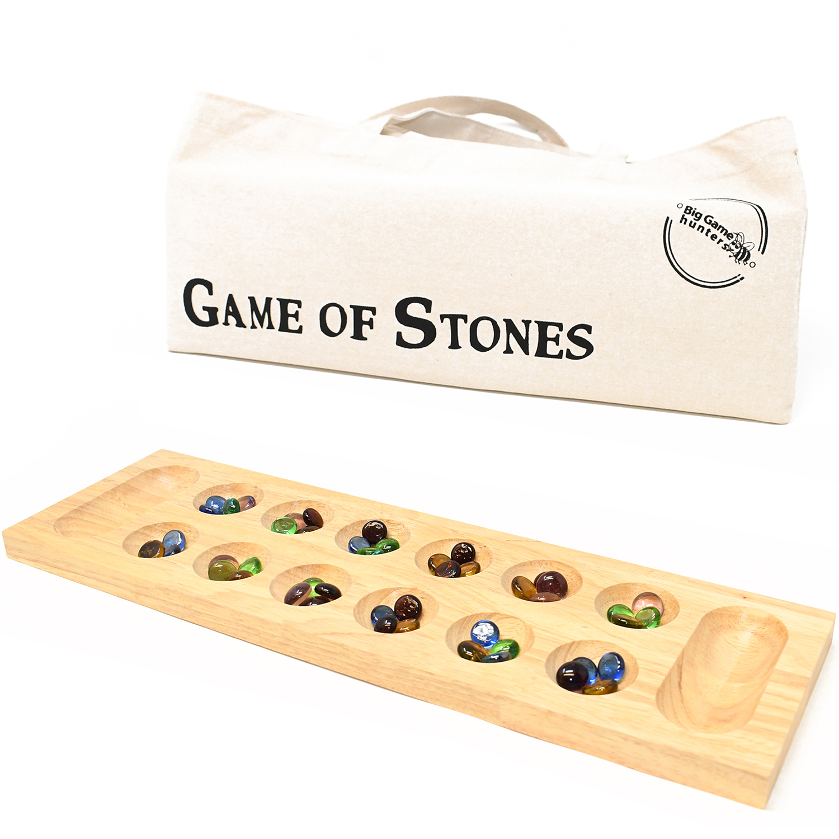
Spark joy

Slide 7
AI Choices
Possible routes:
Zendesk chatbot
Hand-crafted machine learning models
IBM Watson Assistant
Microsoft Azure ecosystem
Full control of the solution
Integrate with third-party services
Manage content and thresholds

Slide 8
Microsoft LUIS
Language Understanding Service
Commence prototype
Spin up free tier
Hit 30%
{}

Slide 9
No PhD needed
!important
You don’t have to understand machine learning concepts to use Microsoft LUIS

Slide 10
For all Intents and Purposes
Applies custom machine learning intelligence to process and interpret natural language text and predict overall meaning

Slide 11
Bucket of Intents
Which bucket should this go in?
Determine the intent (intention) of the utterance (sentence)

Slide 12
Intents
Intent
Goal expressed in an utterance
“How can I pay for this item?” = Shopping.GetPaymentDetails
Intent Flavours
Prebuilt domain intent
Custom intent

Slide 13
Intents: Show and Tell
None*
Email.AutoResponse
Email.Disclaimer
Email.Greeting
Email.SignOff
Email.Subject
Email.WellWishes
Business.GeneralEnquiry
Business.ProductSupply
Business.PriceList
Shopping.Cancellation
Shopping.CheckOrderStatus
Shopping.ComparisonGuide
Shopping.ConfirmDelivery
Shopping.FindItem
Shopping.GetAssemblyInstructions
Shopping.GetContactDetails
Shopping.GetDeliveryInformation
Shopping.GetInvoiceDetails
Shopping.GetItemDetails
Shopping.GetPaymentDetails
Shopping.GetPrice
Shopping.GetStockStatus
Shopping.GetWarrantyInfo
Shopping.OpeningHours
Shopping.OrderAmendment
Shopping.PurchaseOrder
Shopping.ReplacementParts
Shopping.RequestReturn
Shopping.SendComplaint

Slide 14
Entities
Entities
Extracted data from an utterance
“Do you deliver to {Italy}” = geography
Entity Flavours
Custom or prebuilt domain and non-domain entities
Entity Types:
Machine-learned: Learnt and trained over time
Non machine-learned: Static lists

Slide 15
Entities: Show and Tell
age
Communication.ContactName
datetimeV2
dimension
email
geographyV2
job
money
number
ordinal
percentage
personName
phonenumber
Shopping.BrandName
Shopping.Category
Shopping.Colour
Shopping.Complaint
Shopping.DeliveryType
Shopping.Dimension
Shopping.Feature
Shopping.FullItem
Shopping.Material
Shopping.NegativeEmotion
Shopping.Offer
Shopping.OrderNumber
Shopping.OrderReference
Shopping.PaymentMethod
Shopping.Price
Shopping.ProductName
Shopping.ProductType
Shopping.Quantity
Shopping.Recipient
Shopping.Size
url

Slide 16
Model
Model:
Mathematical representation of statistical data that has been trained over time to fit our problem space
What model does LUIS use under the hood?
Supervised learning (labelled data) as opposed to unsupervised learning
Classification of sentences into intents (categories)

Slide 17
LUIS: Test, Train and Publish the Model
Test utterances in real-time
Train the LUIS model with changes
Publish the improved model

Slide 18
LUIS Test Response
LUIS breakdown:
Utterance: “I’d like to find out where my order is”
TopScoringIntent: Shopping.CheckOrderStatus
Score: 0.702 (0-1)
Entities: “my order” (Shopping.OrderReference)
Sentiment: 0.97 (positivity 0-1)

Slide 19
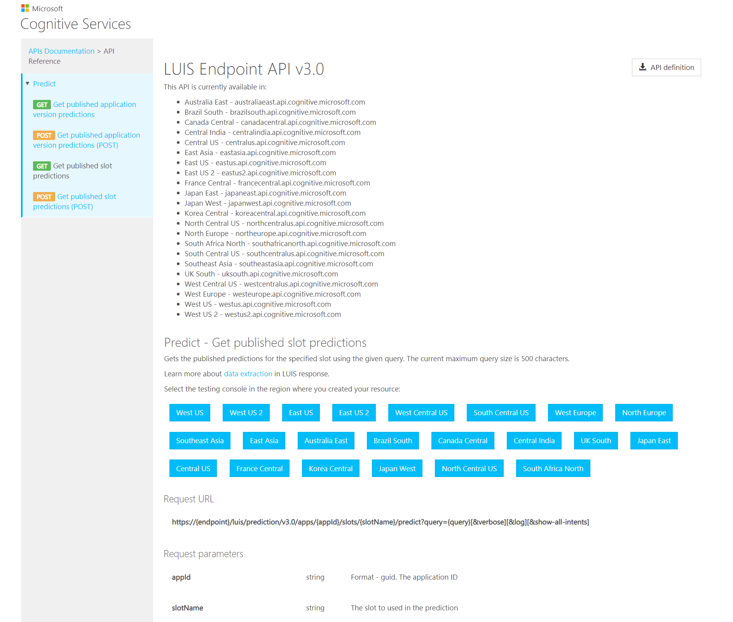
LUIS Endpoint API v3.0
LUIS developer API for Authoring and Predictions

Slide 20
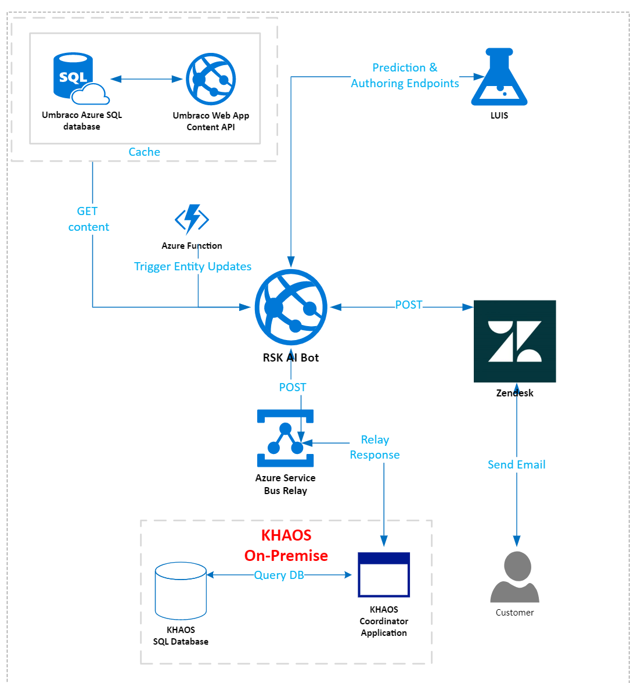
Topology

Slide 21
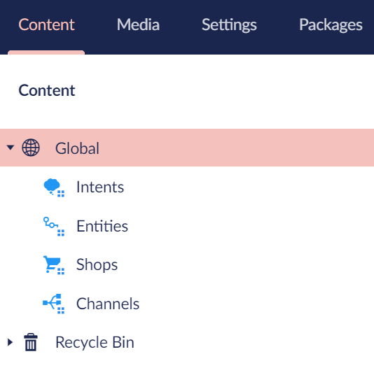
Umbraco - Global
Global
Structure content around Intent
Reassure negativity threshold %
Minimum score threshold %

Slide 22
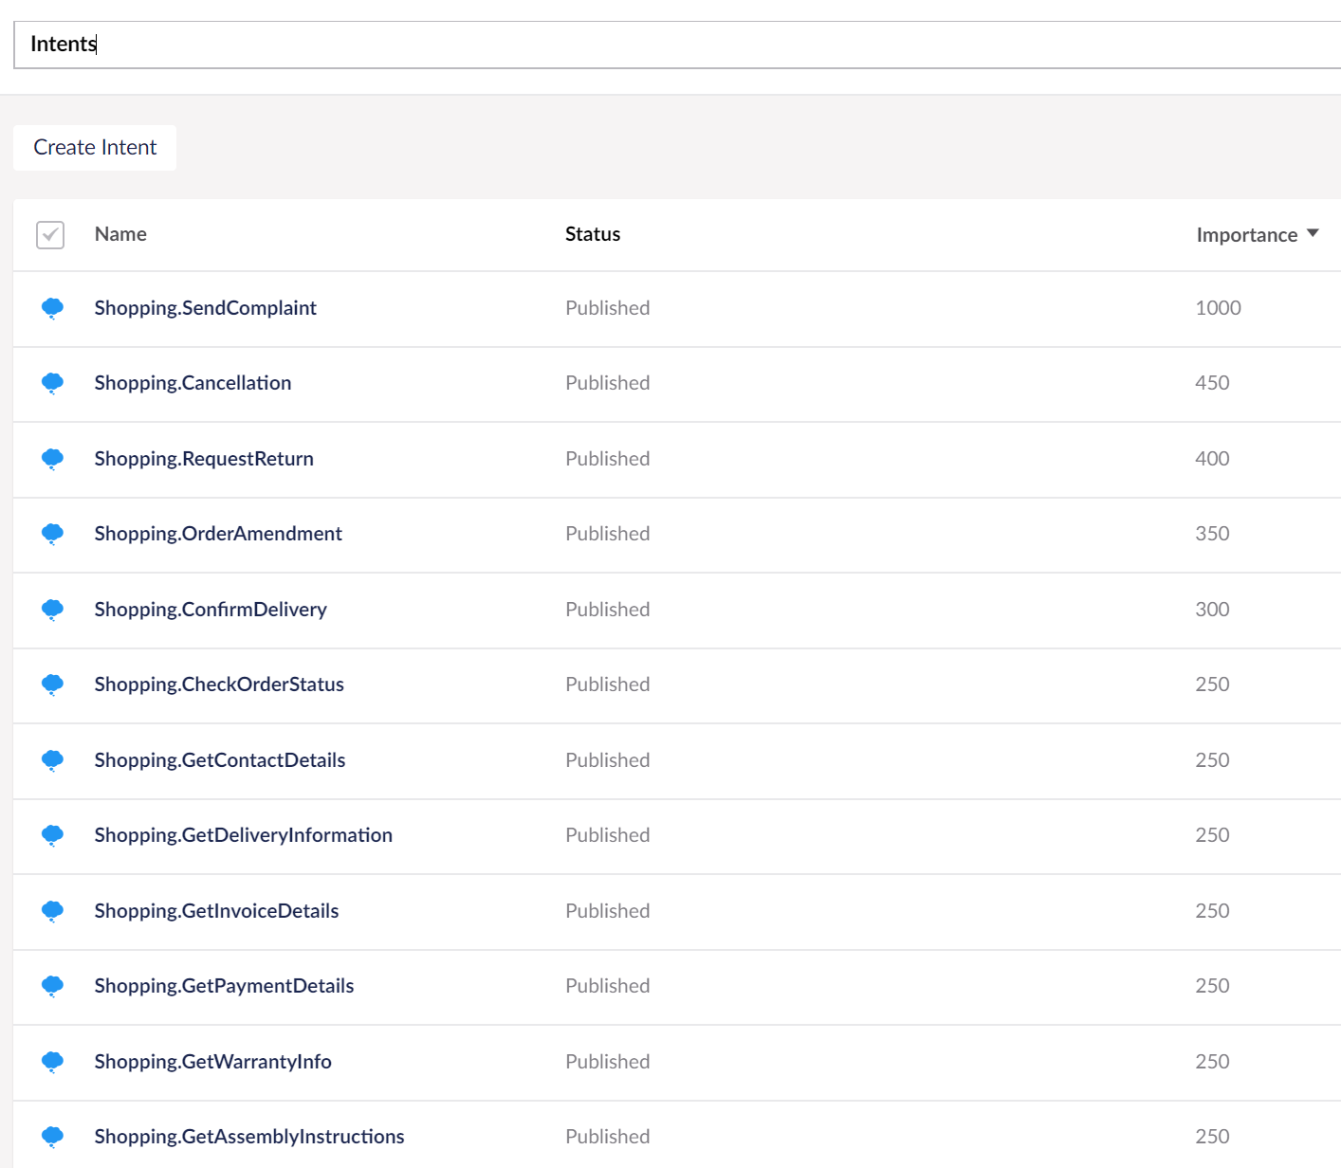
Umbraco - Intents
Intents
Each LUIS Intent has a matching Umbraco Intent
Content based on Shop and Channel
Ignore intent
Helpdesk Priority
Tag manual reply
Assign Agent
Set public response
Importance

Slide 23
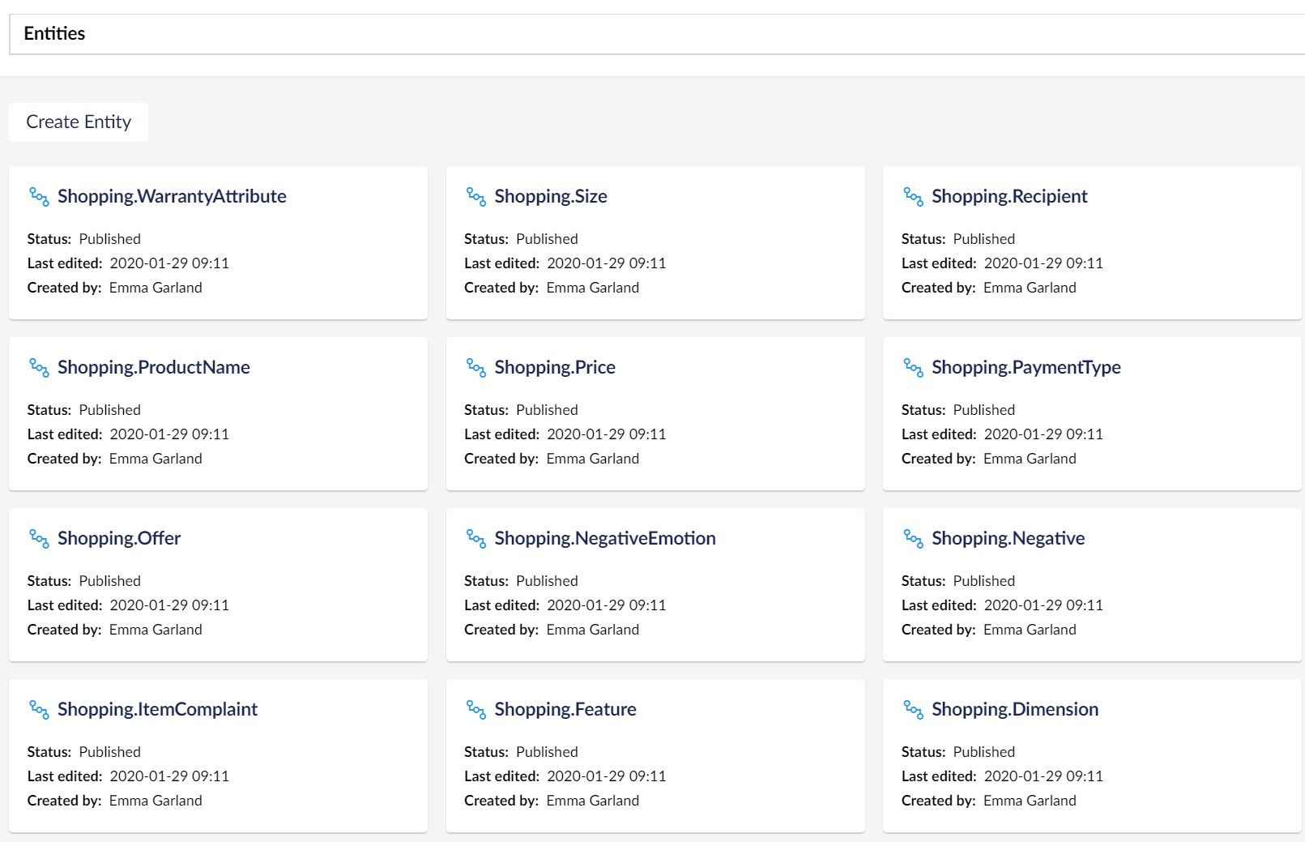
Umbraco - Entities
Entities
Each LUIS Entity has a matching Umbraco Entity
Content reply for Intents can be customised with entities via {{handlebars}}
Dynamic content injected
“You sound like you’re asking about a delivery to {Italy}”

Slide 24
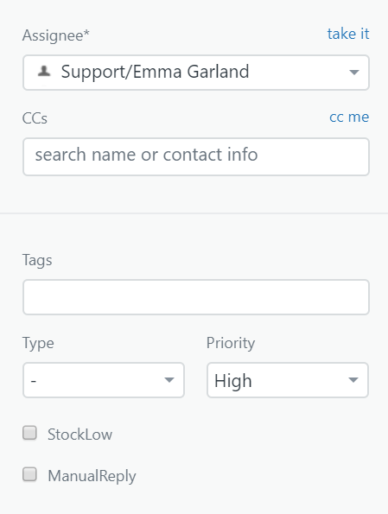
Zendesk API
Zendesk API allows us to update ticket fields:
Private or public response
Custom tags and priorities
Set an assigned agent
Set manual reply or stock low tag

Slide 25
LUIS is Learning!
Where will LUIS put the Intent?

Slide 26
The Art of Discarding
Email styles are very different
Not clear what the intention is
Discarding to reduce noise around the Intent(s)
Email.Greeting
Email.Signoff
Email.Disclaimer
Email.WellWishes
Set number of endpoint hits until charged
Minimise via pre-processing
OpenNLP to initially detect sentences
Recognise Forwards

Slide 27
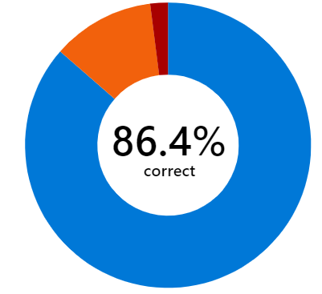
How do we know if we’re getting it right?
LUIS dashboard to review the overall prediction accuracy and investigate problematic intents
A MASSIVE SPREADSHEET! % tracked by date
Comparing model results using unsullied data & custom test tool
Batch testing in LUIS

Slide 28
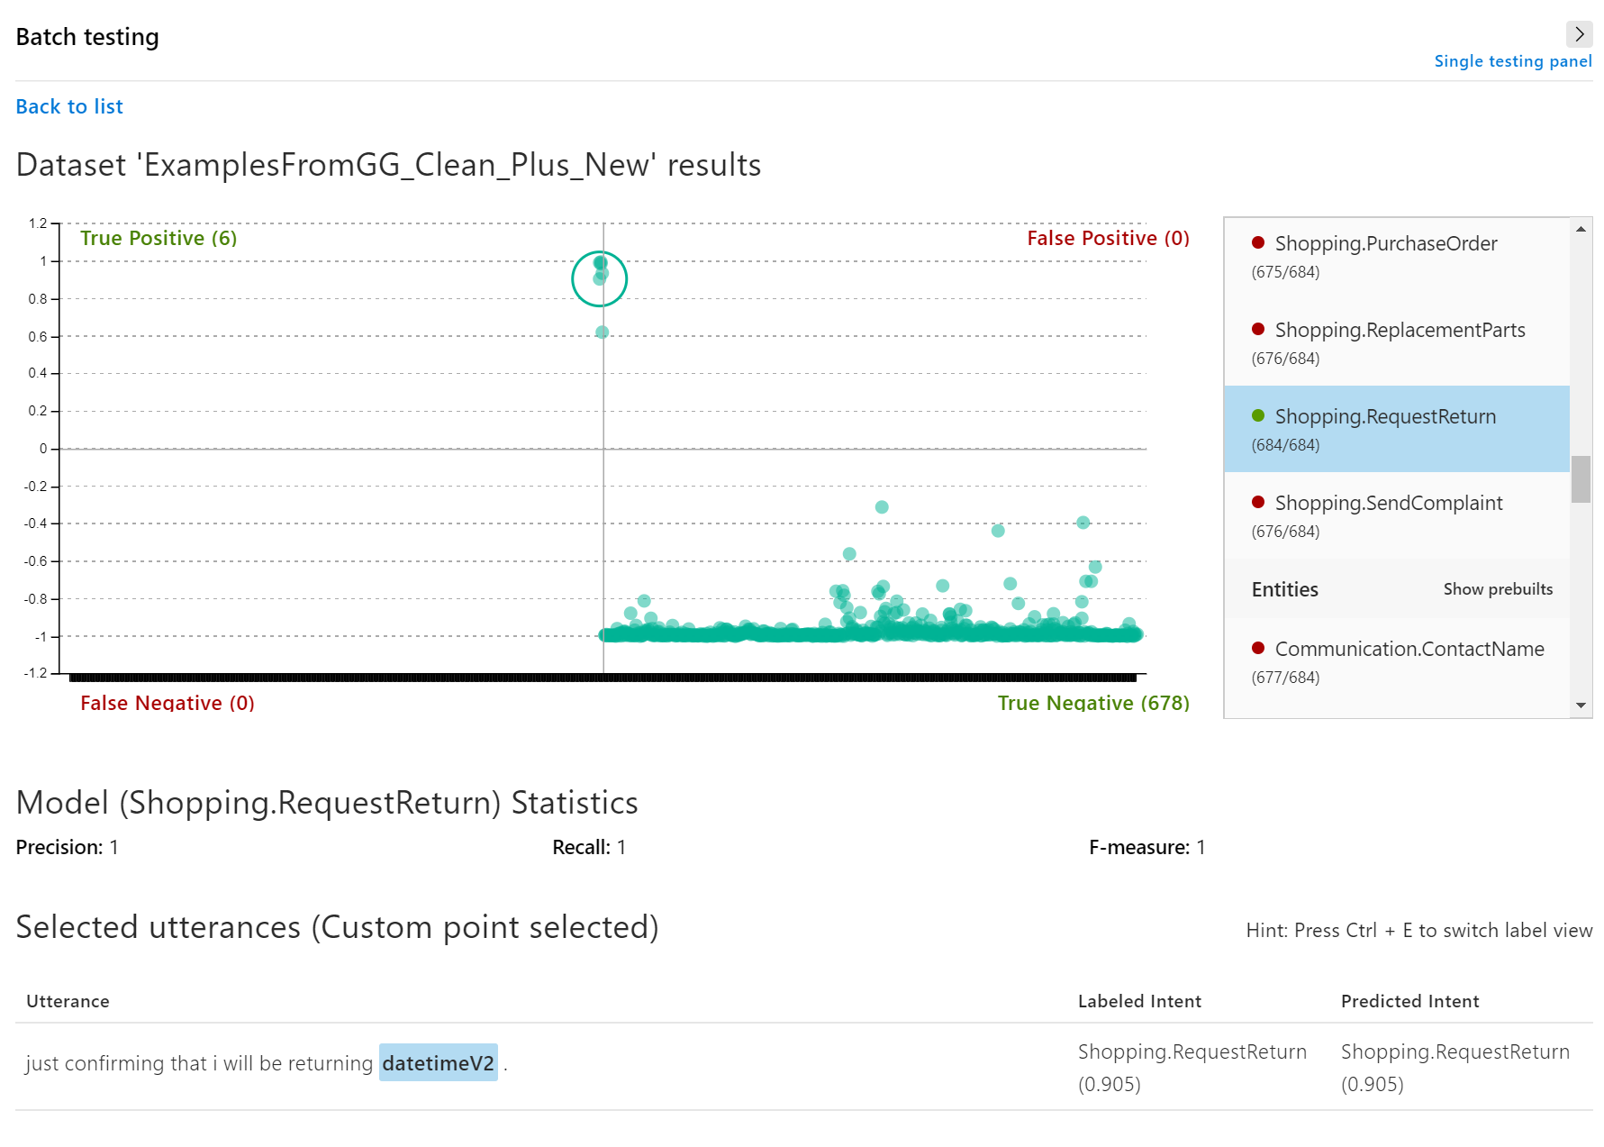
LUIS Batch Testing

Slide 29
How do we improve things if we’re not getting it right?
Test and train LUIS to strengthen the model
Model version
Overfitting:
Testing and training same data skews results
Underfitting
Not enough training

Slide 30
What happened when we switched it on?
Best moments
Helping, not replacing, agents
Luis is a named employee
Hit 30%!

Slide 31
Future
Productise
New contextual ways to interact
Make handlebars dynamic
Translations
Use Umbraco to publish and train utterances for LUIS

Slide 32
I NEVER WANT TO WORK ON ANYTHING ELSE*
*but I know I might have to

Slide 33
Resources
LUIS: https://luis.ai
LUIS Best Practices: https://docs.microsoft.com/en-us/azure/cognitive-services/luis/luis-concept-best-practices
LUIS Developer Reference: https://docs.microsoft.com/en-gb/azure/cognitive-services/LUIS/developer-reference-resource
The Life-Changing Magic of Tidying Up - Marie Kondo
The Art of Discarding: How to Get Rid of Clutter and Find Joy - Nagisa Tatsumi

