Slide 1
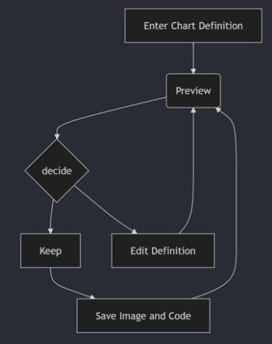
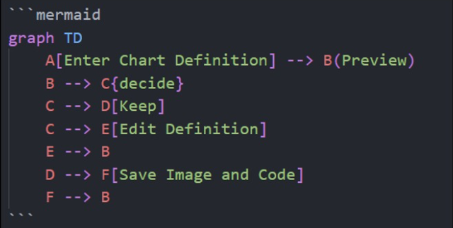



Process Maps As Code
With mermaid
Richard Jackson | @jacksorjacksor

Slide 2

ABOUT ME:
Richard Jackson
Cardiff-based Umbraco MVP
Cloud Software Engineer at Nightingale HQ
Dev by day, musician by night, tired all the time

Slide 3
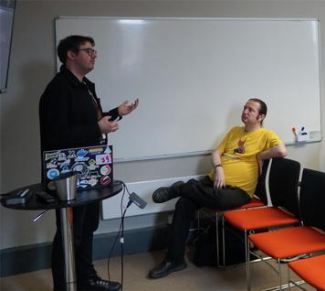
Dedication
Terence Burridge
Photo: Carl Sargunar, DDD South West - April 2024

Slide 5
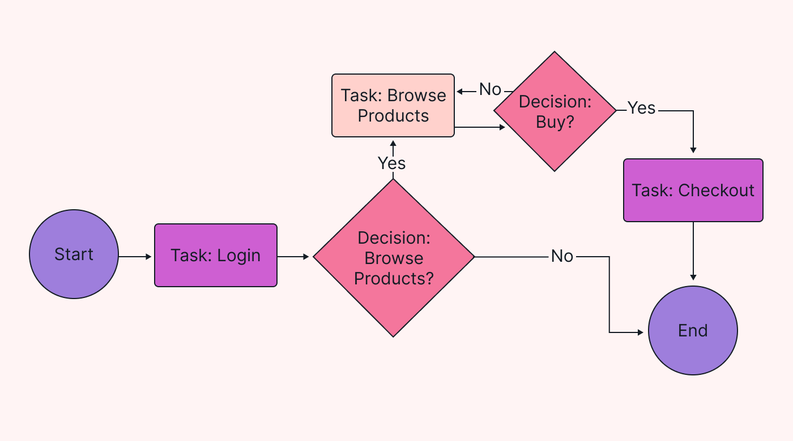
What are process maps?
Process maps are
pictures that
tell you how stuff happens
“graphic documentation”
Notes:
TODO: replace image with UMBRACO related one
BEGIN:
END:
This is something I’ve talked about a lot
What are Process Maps?
Our 10-minute lightning talk version of this definition is

Slide 6
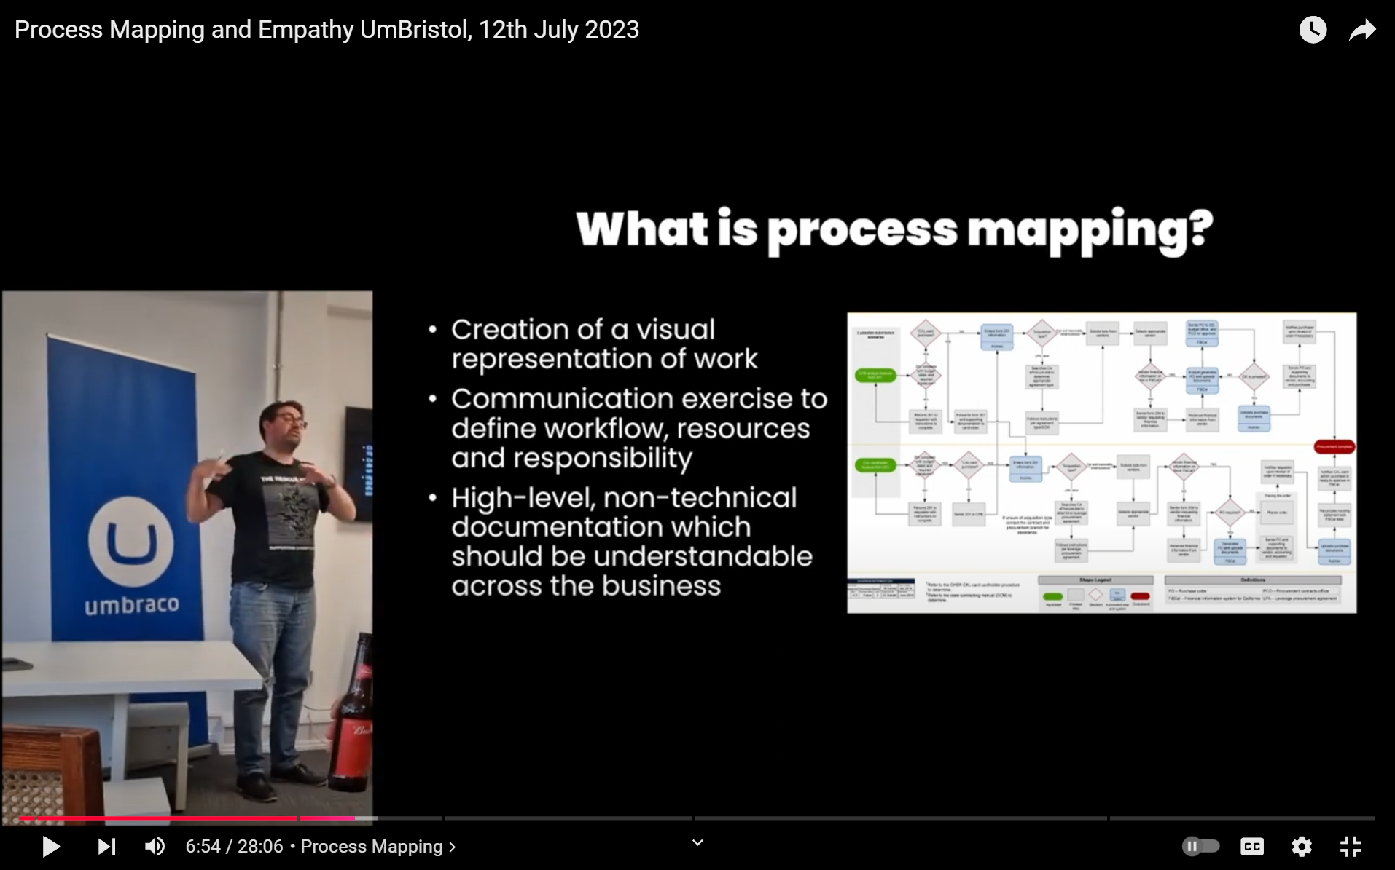
Notes:
This talks about the importance of documentation, which is largely summarised by this slide here:
Advocating for process maps being Useful
END: and in this talk, one of my most important slides to me is this one here:

Slide 7
If Process maps are a useful form of documentation…
…how can you incorporate process maps into your workflow?
Notes:
So to reiterate

Slide 8



Graphics Packages for Process Mapping
Diagrams.net
(formally Draw.io)
Lucidchart
Microsoft Visio

Slide 9
Key problems with making & maintaining process maps
Requires upskilling on graphics package
Images are hard to maintain
Separate file to the work

Slide 10
Process Maps as Code
Requires upskilling on graphics package
  Same dev skillset, New language
Images are hard to maintain
  Code can be easily updated
Separate file to the work
  Can be added into codebase / source control

Slide 11
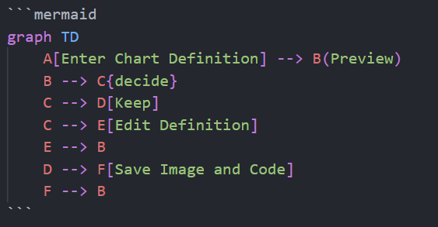
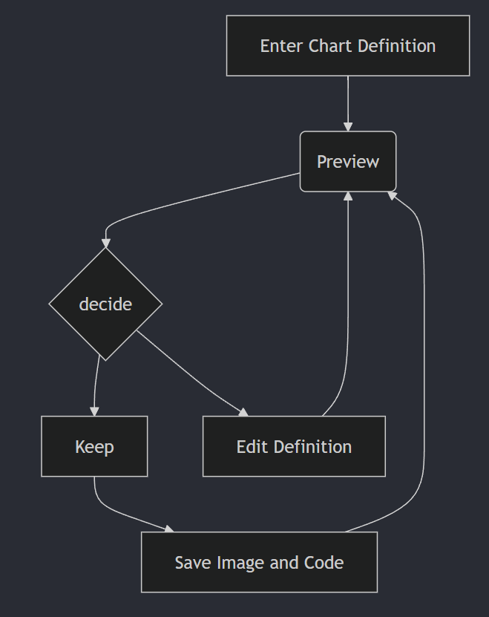
PROCESS MAPs AS CODE with
Mermaid

Slide 12
About Mermaid
Open-source JavaScript-based diagramming and charting tool
using Markdown-inspired syntax
Goal: Help documentation catch up with development
Won the JS Open Source Awards (2019) category for…
"The most exciting use of technology"

Slide 13
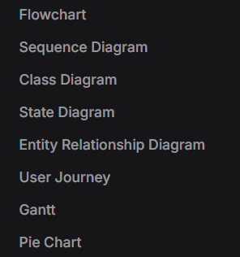
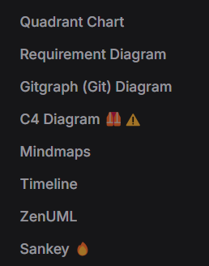
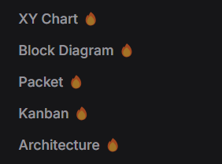
Mermaid: Types of process maps

Slide 14
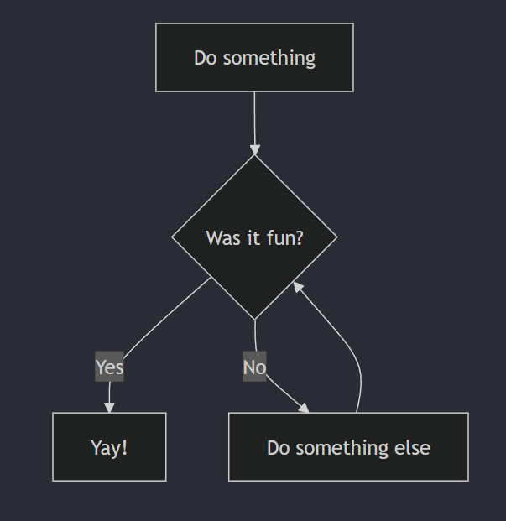
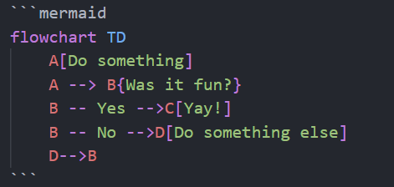
Flowchart

Slide 15
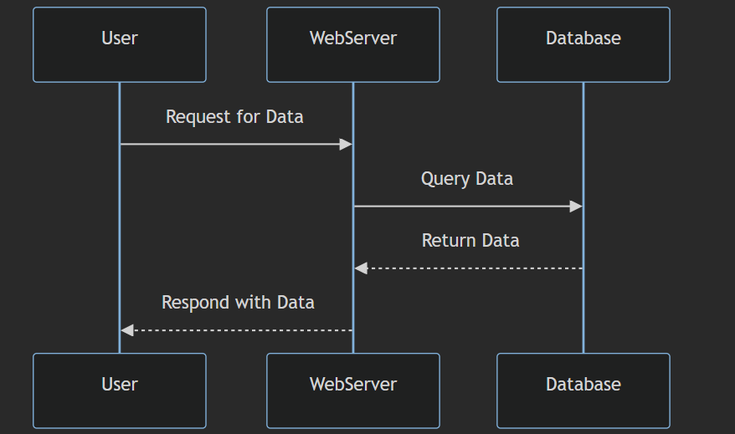
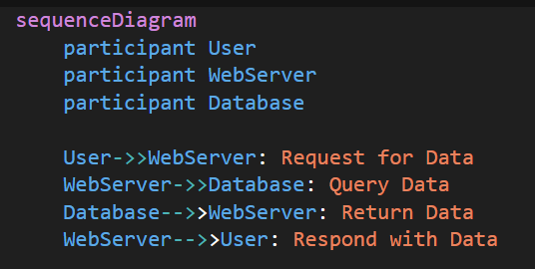
Sequence Diagram

Slide 16
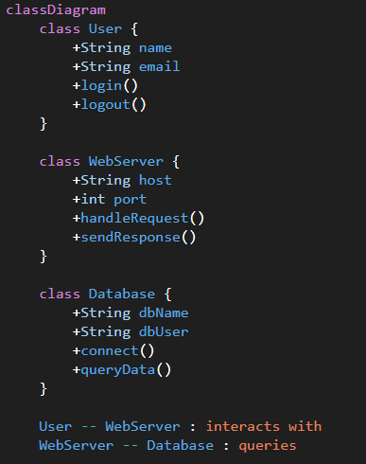
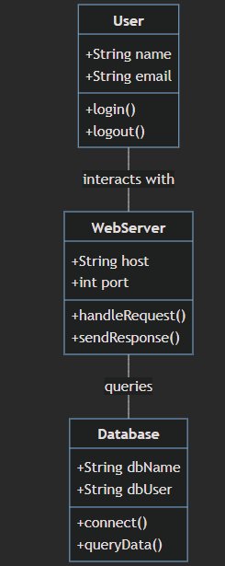
UML Class Diagram

Slide 17
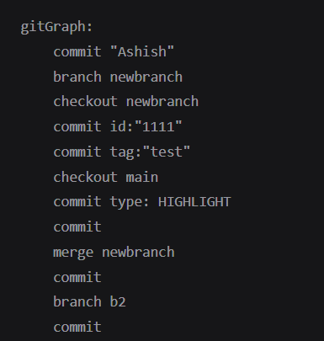
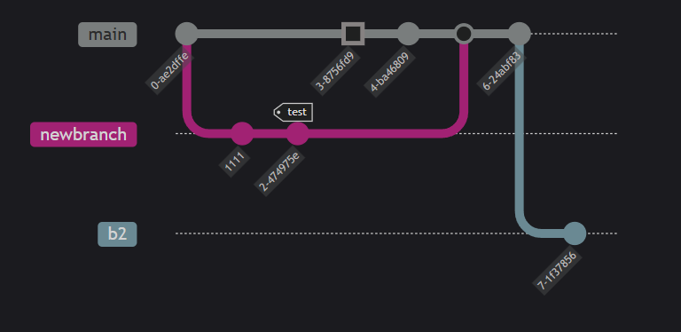
Gitgraph

Slide 18
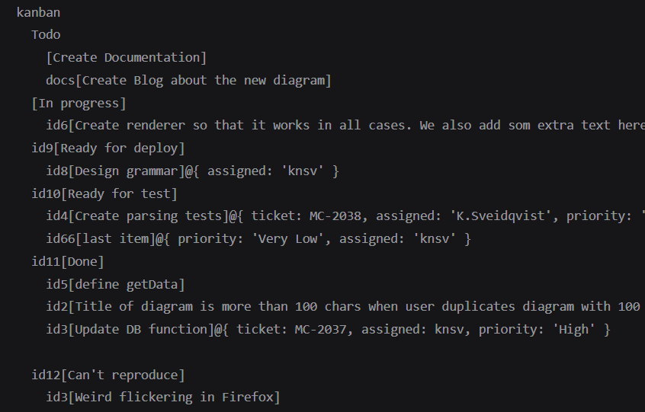
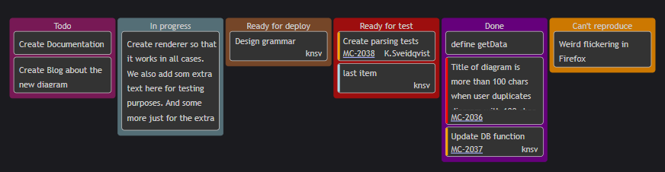
KanbaN

Slide 19
Syntax
Markdown file
Language specifier
Metadata
Chart type
Shape text
Variable initialiser
Arrow type
Shape definition

Slide 20
Example: Flowchart
Metadata

Slide 21
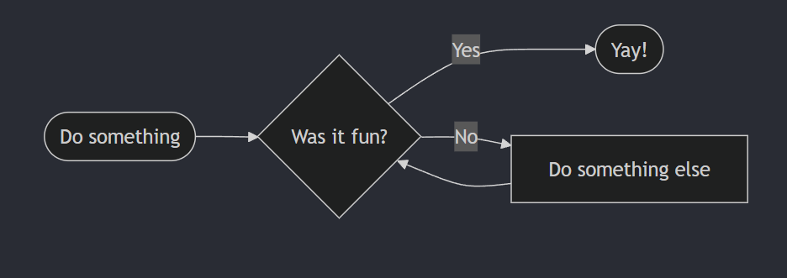
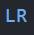
Example: Flowchart
Metadata

Slide 22
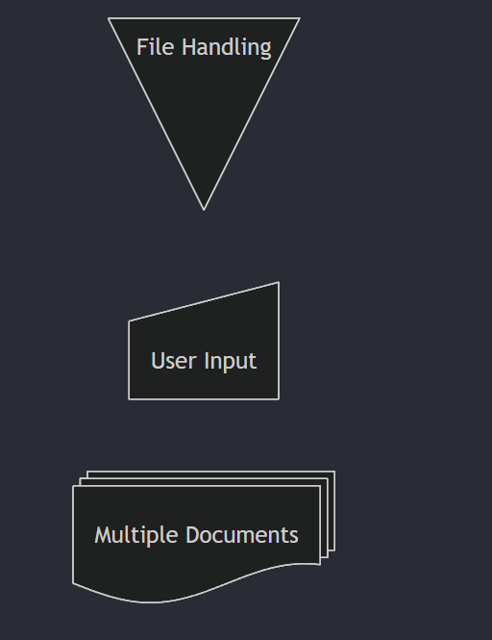
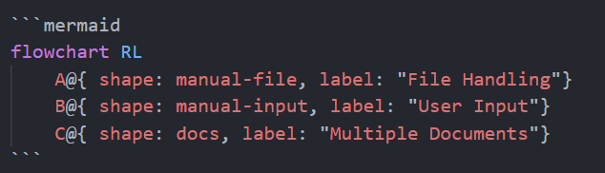
Defining Shapes
Flowcharts Syntax | Mermaid
Notes:
Shapes are not just limited to bracket types – can also be used for infrastructure diagrams

Slide 23
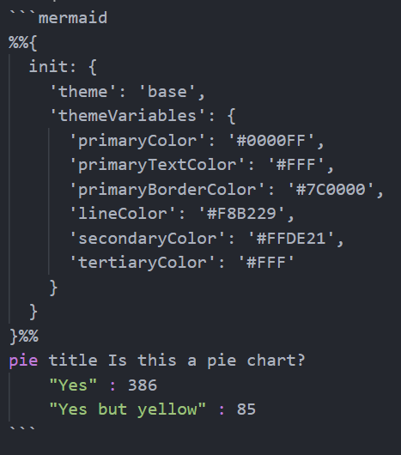
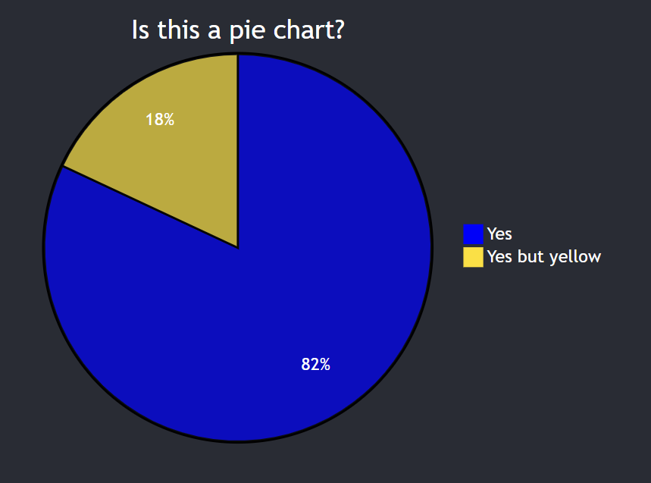
THEMES (‘colours’)
Base theme allows for user-defined colour palettes

Slide 24

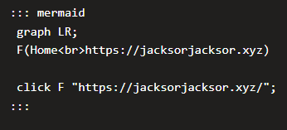

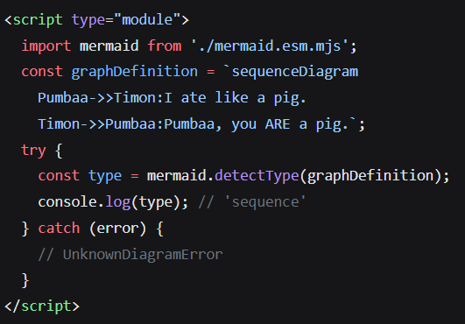
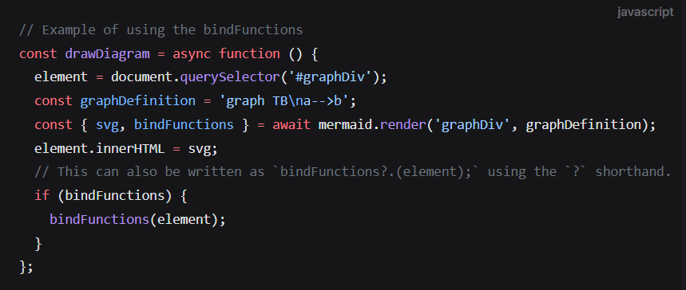
Click Events
Binding Events
API

Slide 25

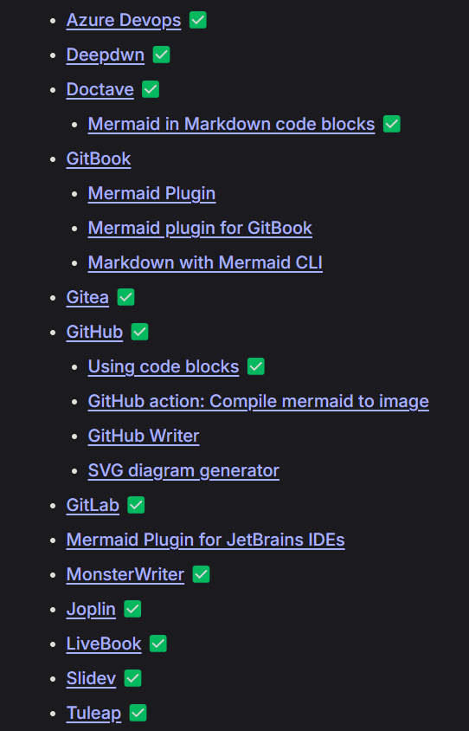
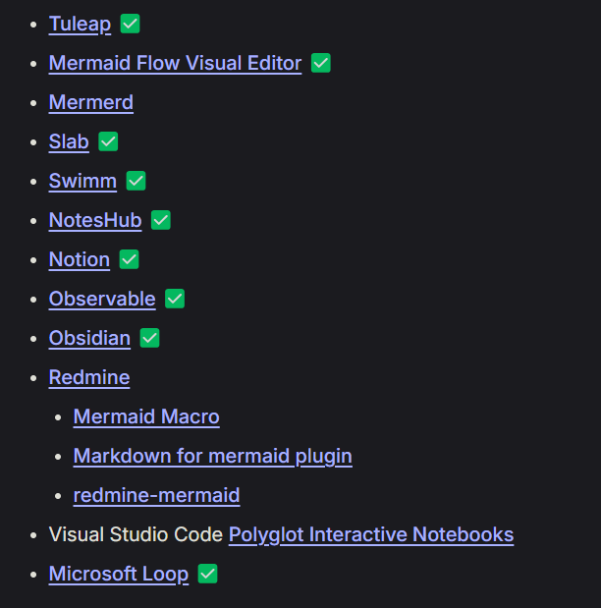
Mermaid JS
Integrations
Native support for Mermaid
Source
control
Note taking
Notes:
Source control platforms
Notetaking / information management tools

Slide 26

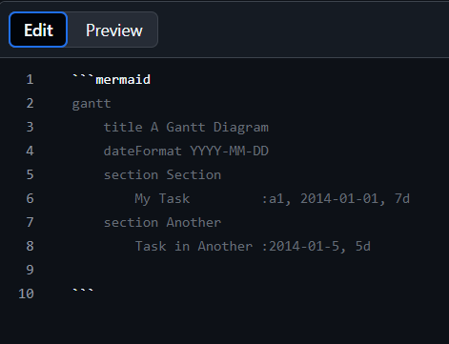
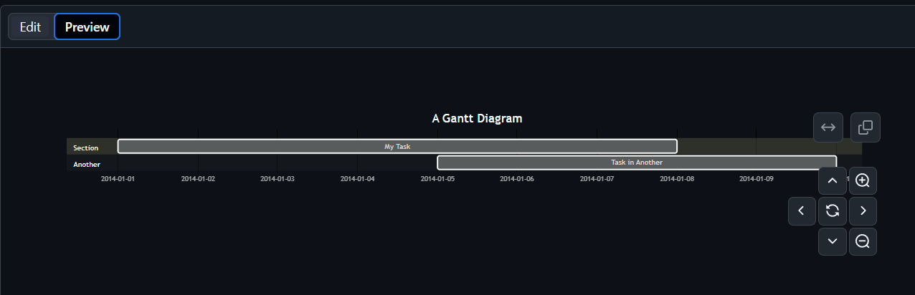
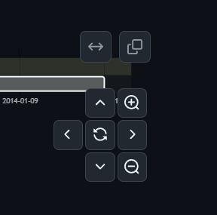
GitHub
Any Markdown file
Available since Feb 2022:
Include diagrams in your Markdown files with Mermaid - The GitHub Blog

Slide 27

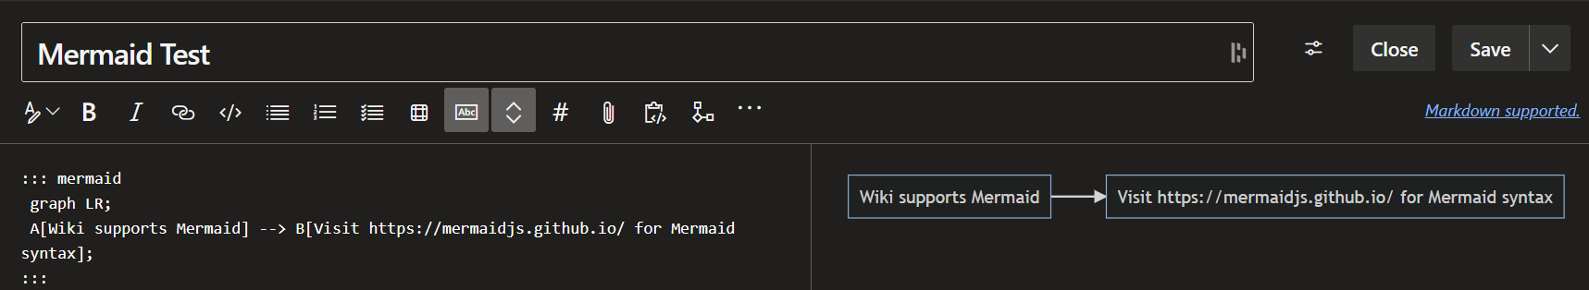
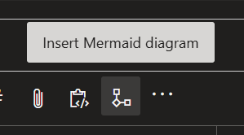
Azure DevOps
Wiki Entries only

Slide 28
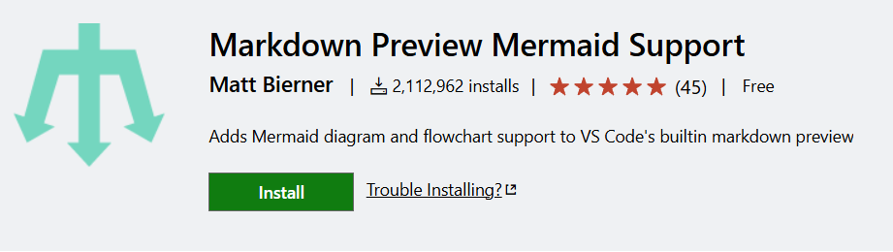
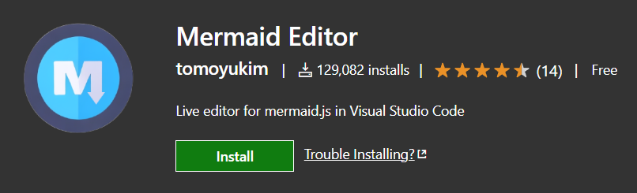
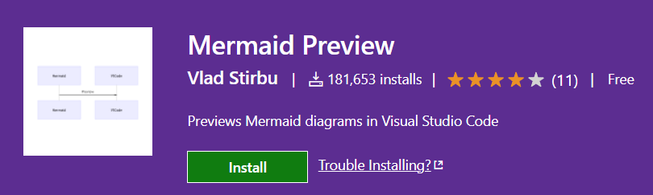
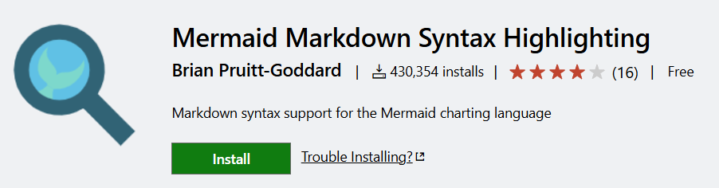
Visual Studio Code
Extension required

Slide 29
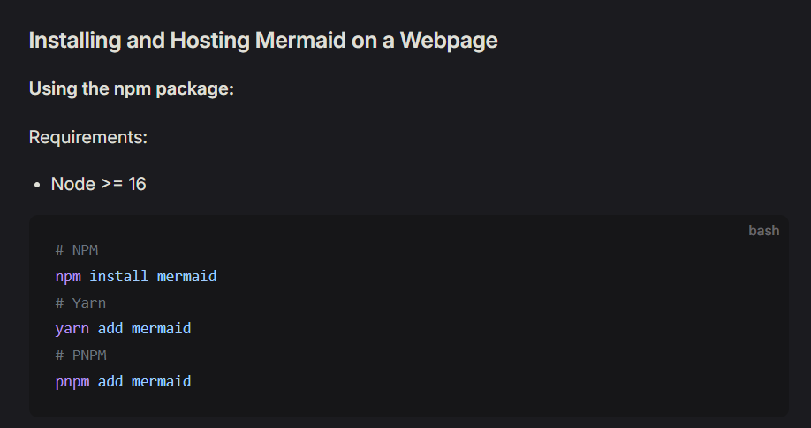
Web page

Slide 30

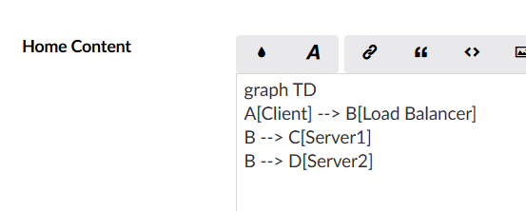
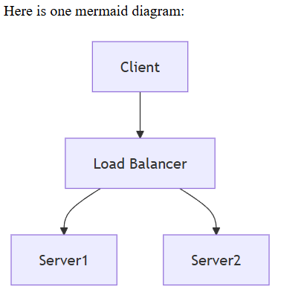
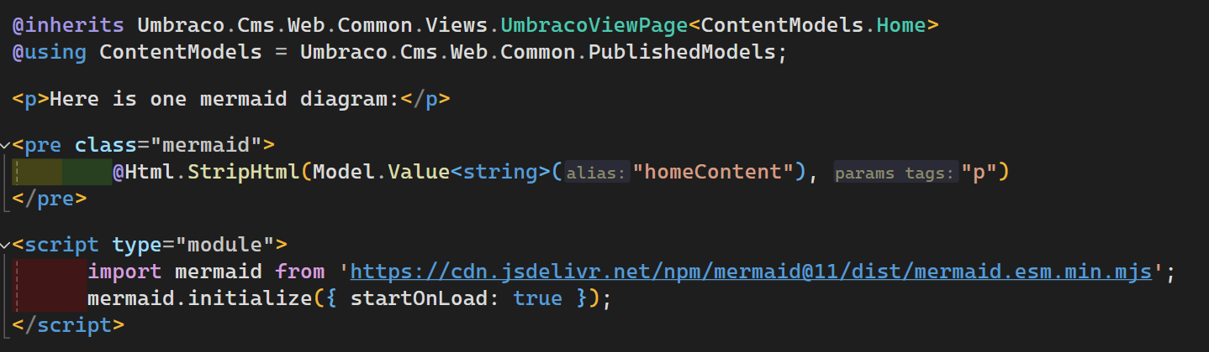
Umbraco CMS (v13)
[Markdown Editor]

Slide 31
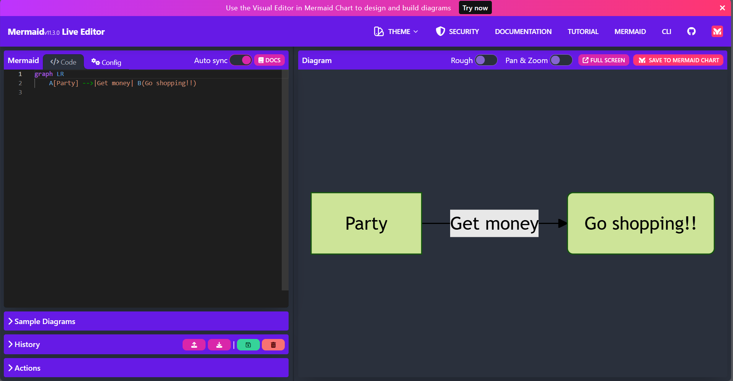
Mermaid Live Editor
https://mermaid.live

Slide 32
Mermaid Live Editor

Slide 33
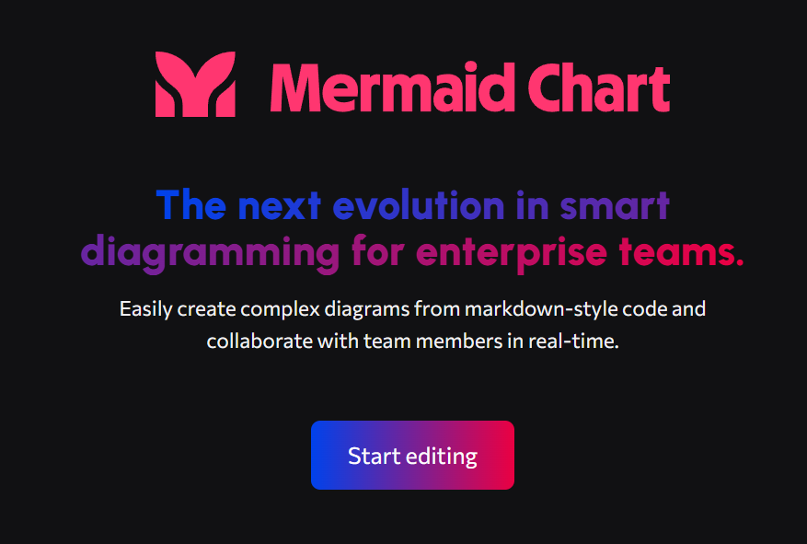
AKA a commercialised platform hosting Mermaid tools
All integrations shown so far have been free

Slide 34
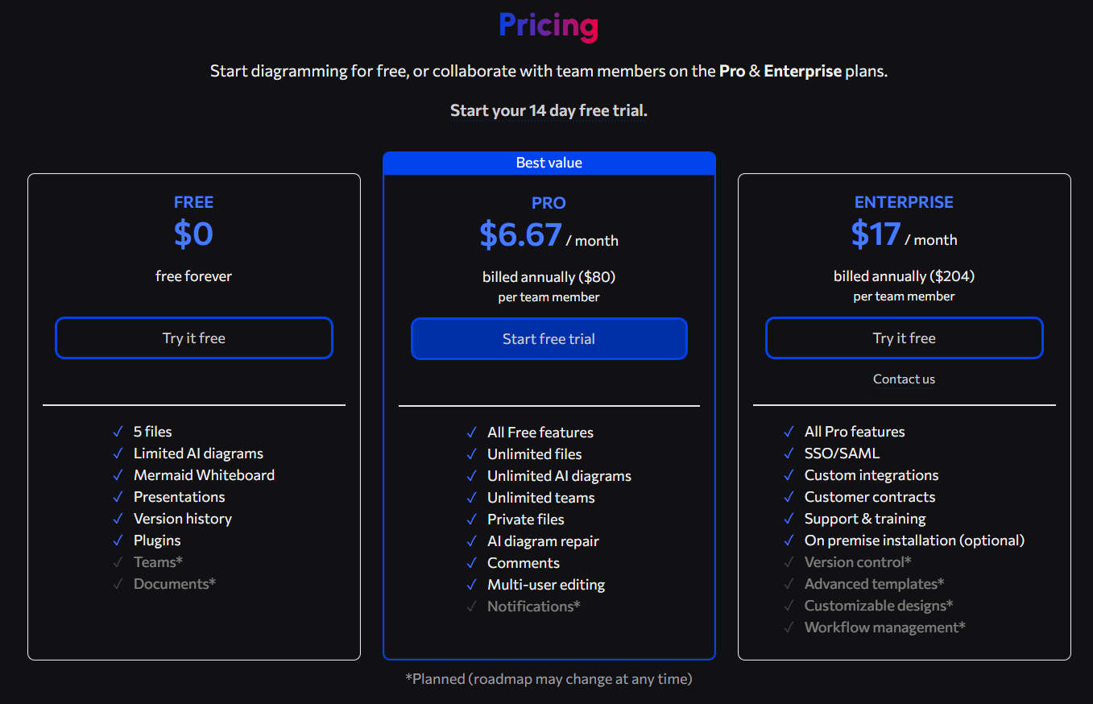
Screenshot:
7th November 2024

Slide 35
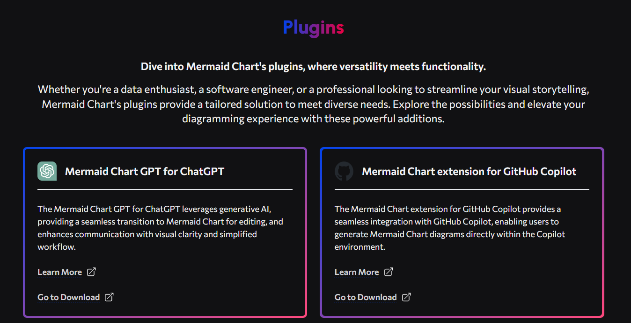

Slide 36
Developing with AI + Mermaid
Describe problem
Describe problem
Devs test code
Agent creates Mermaid
Devs test code
Agent creates Mermaid
Agent creates code
Agent creates code
Devs confirm Mermaid
Devs confirm Mermaid

Slide 37
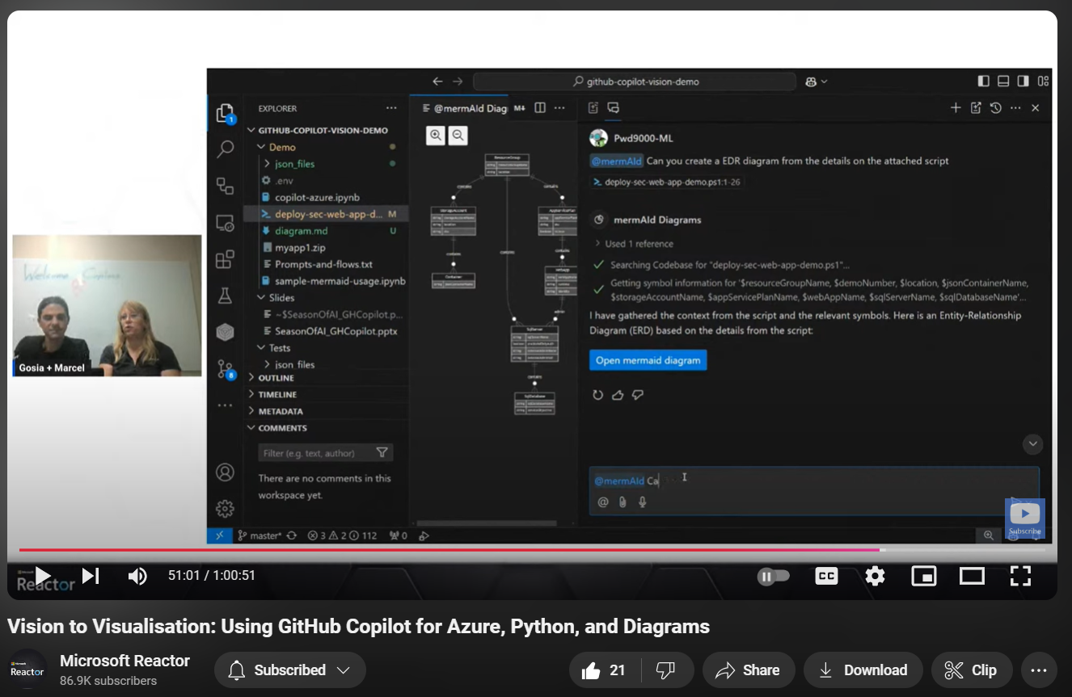

Slide 38
Pictures are useful
SUMMARY
Devs like code
Mermaid makes
pictures from code

Slide 39
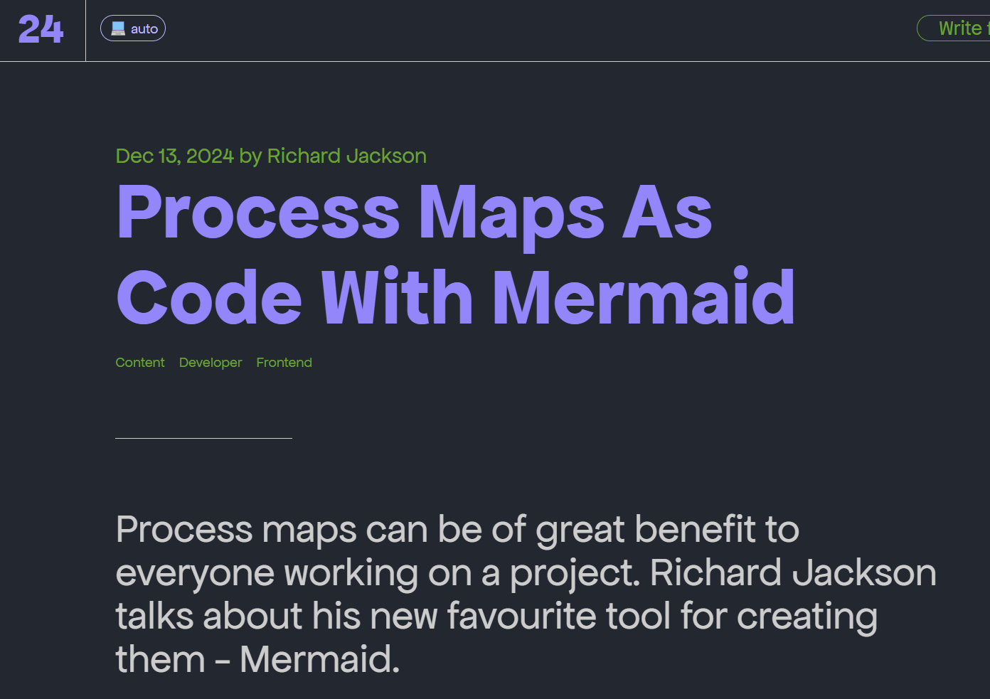

24 Days in Umbraco Article
Notes:
If you’d like to learn more about this topic then I wrote an article about it in last year’s 24 days in Umbraco, alongside other articles such as this sample from Joe Glombek

Slide 40
BUT WAIT, THERE’s MORE!

Slide 41

Notes:
Everytime I tell a very special person to me that I’m doing talks and blogs about Mermaid

Slide 42


SING-A-LONG
“Part of your world”
♫

Slide 43
♫
Up where they walk Up where they run
Up where they stay All day in the sun
♫

Slide 44
Wandering free
Wish I could be
Part of that world

Slide 45
Thank you for listening!
Richard Jackson
@jacksorjacksor

