Slide 1
Semantic Search for Heartcore
Howard Bayliss
LinkedIn Connections Welcomed: https://www.linkedin.com/in/howard-b-1719231b4/
Slide 1 of 239

Slide 2
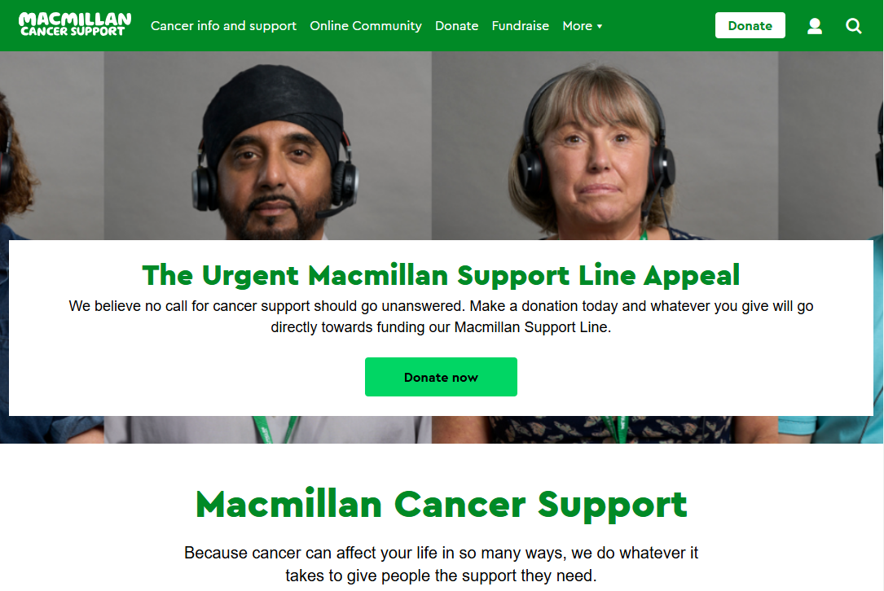

Slide 3
Heartcore Search
“Where search is concerned, we have some improvements that we wish to make”
“…we likely will not be starting this work until end of 2024 at the earliest”

Slide 4
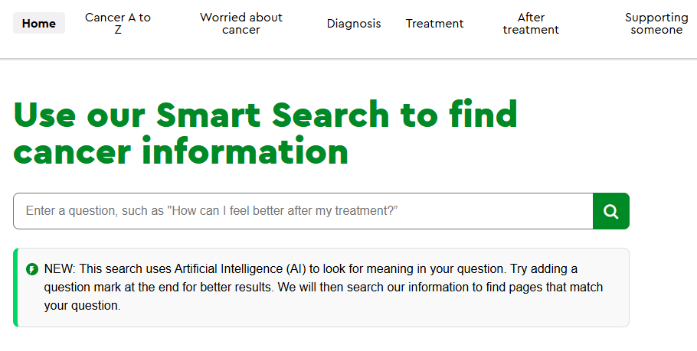

Slide 5
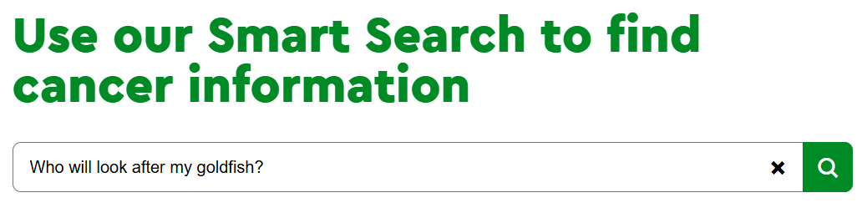

Slide 6
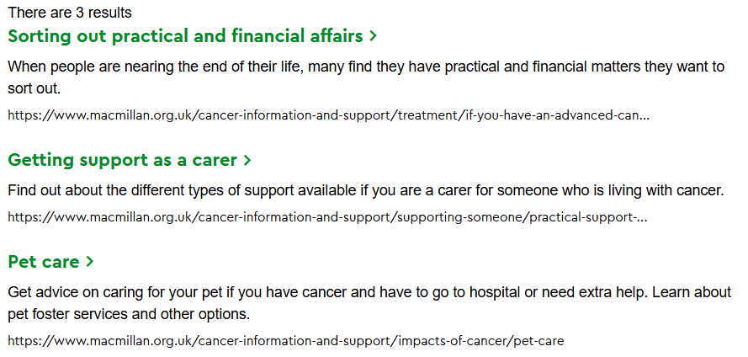

Slide 7
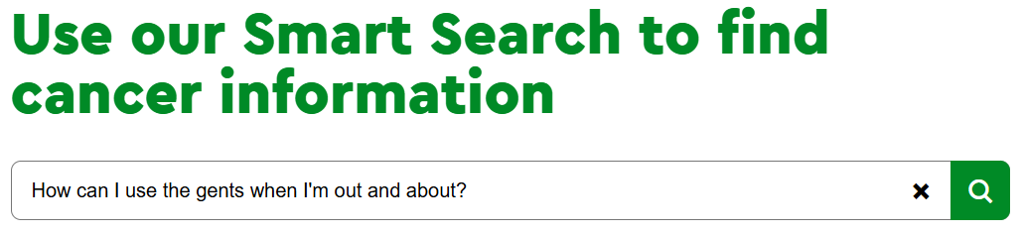

Slide 8
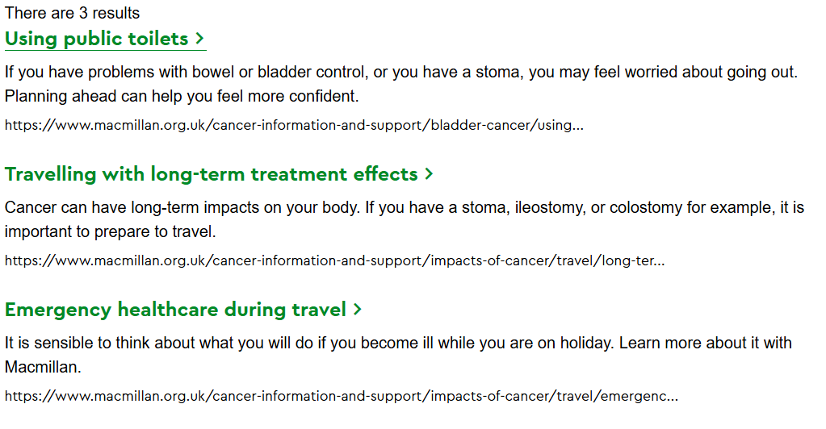

Slide 9
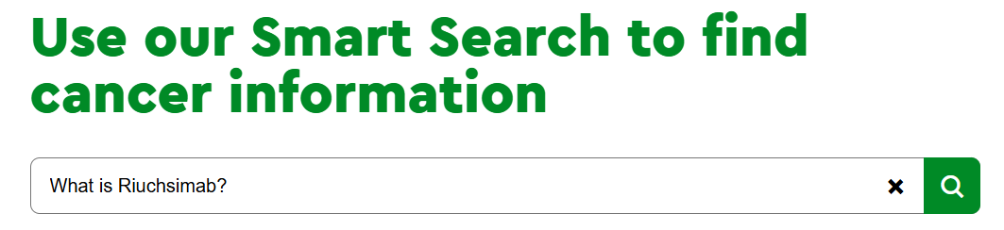

Slide 10
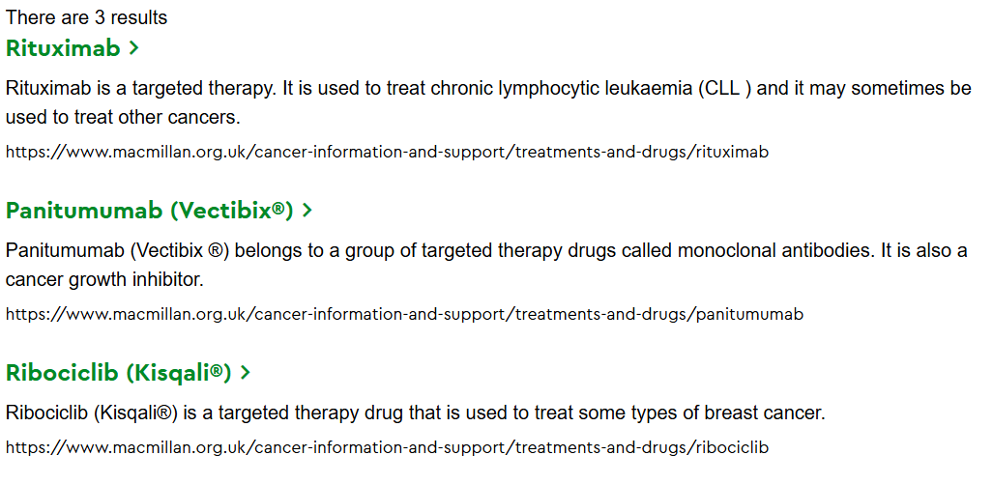

Slide 11
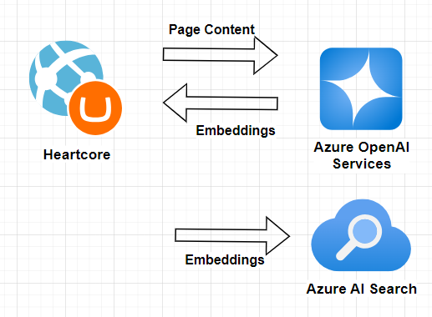
Semantic Search – Indexing

Slide 12
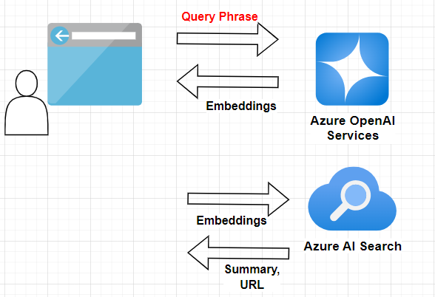
Semantic Search - Query

Slide 13
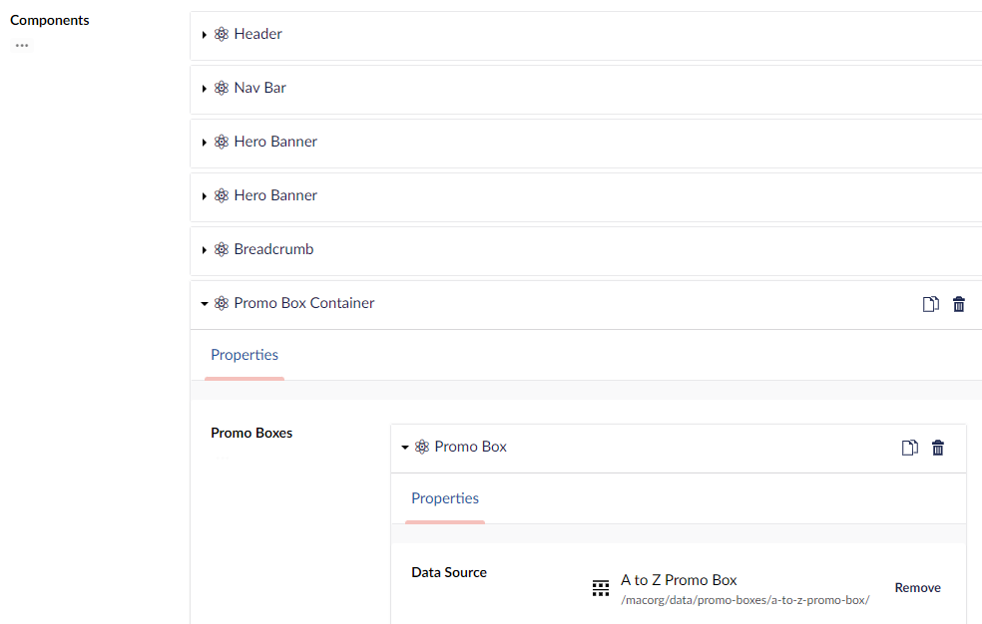

Slide 14
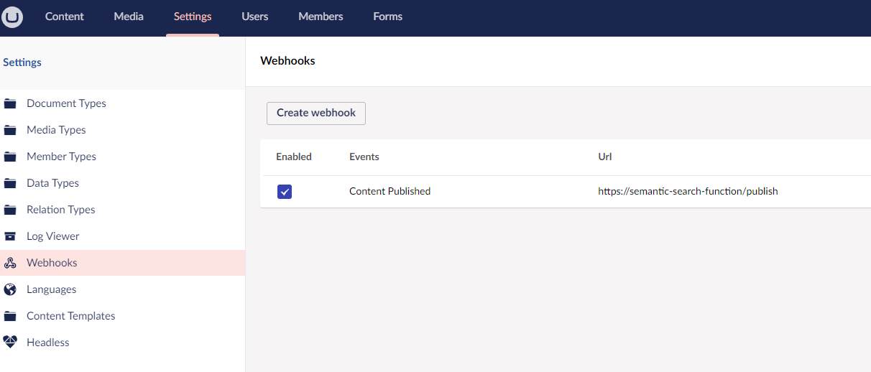

Slide 15
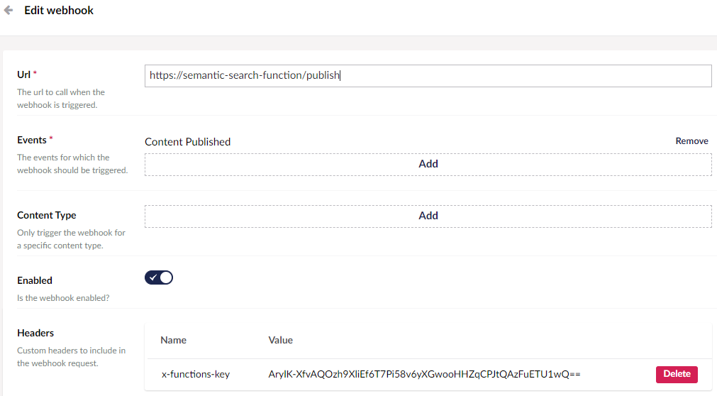

Slide 16
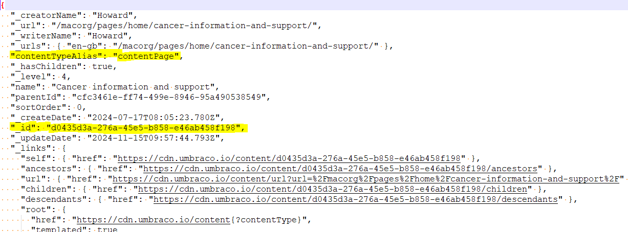

Slide 17
Relations API
https://api.umbraco.io/relation/child/6256d5df-7ad3-4839-8b3d-ca3c43e24c5b

Slide 18
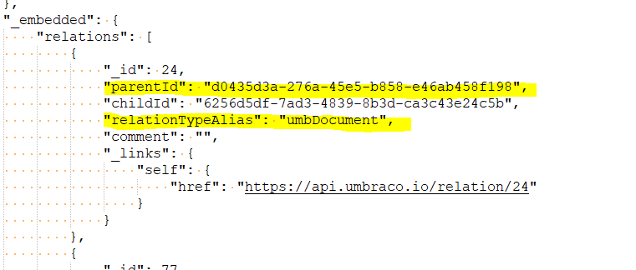
Relations API - Response

Slide 19
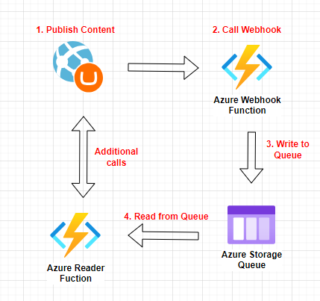

Slide 20
Finally…

Slide 21
Thank You
The end

